Slide 1
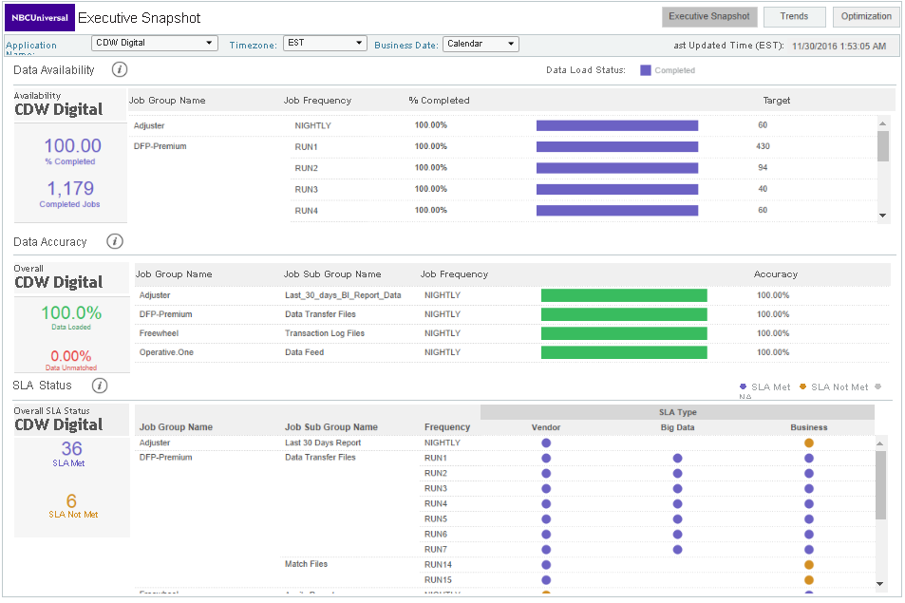
EACS Dashboard – Data Availability, Accuracy and SLA Status
Data Availability
Data Accuracy
SLA Status

